Slide 1

Economic Evidence Base for North Norfolk District Council
June 2024
Produced by the Norfolk Office of Data & Analytics (NODA)
This document has been compiled by the Norfolk Office of Data & Analytics using publicly available data.
Please do not copy, cite, or distribute without permission of the author(s).

Slide 2








People

Slide 3
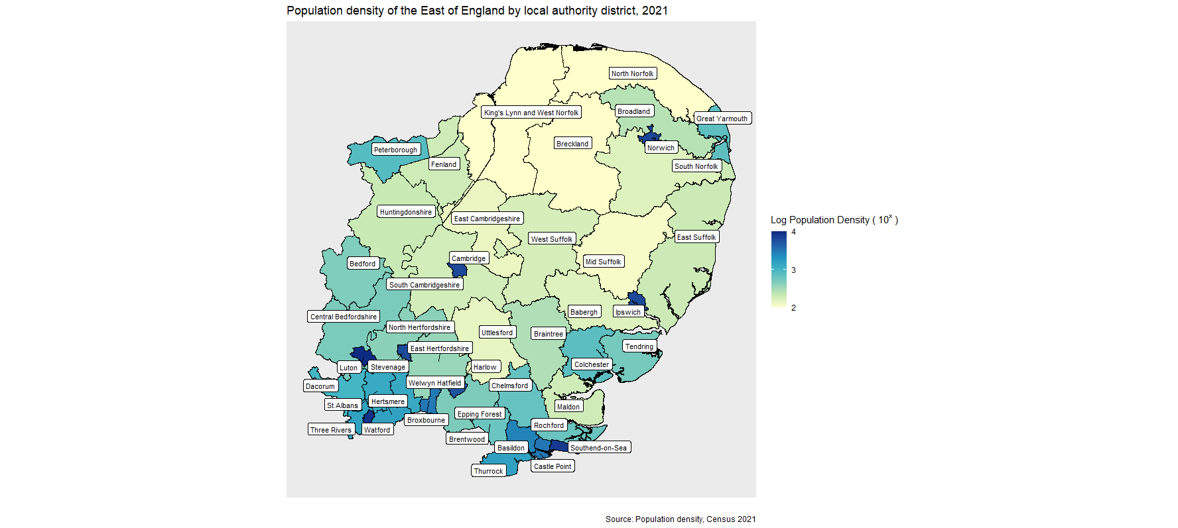
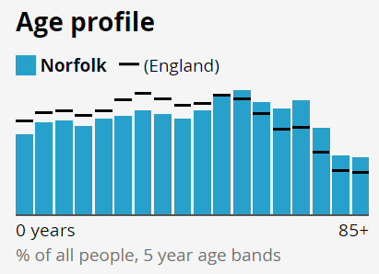
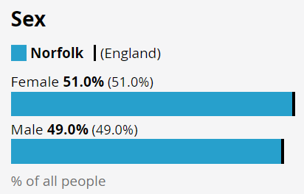
Population
Population density (number of usual residents per square kilometre) within East of England by local authority district, 2021
Norfolk has an estimated population of around 916,100 people.
Norfolk’s population has a much older age profile than England as a whole, with 24.4% aged 65 and over, compared with 18.4% for England.
Norfolk's population aged 65 and over are more concentrated within the rural and coastal parts of the county, in contrast to the working age and younger residents being within the more urban areas.
Source: Norfolk Population Overview August 2023 (norfolkinsight.org.uk) & Build a custom area profile - Census 2021, ONS

Slide 4
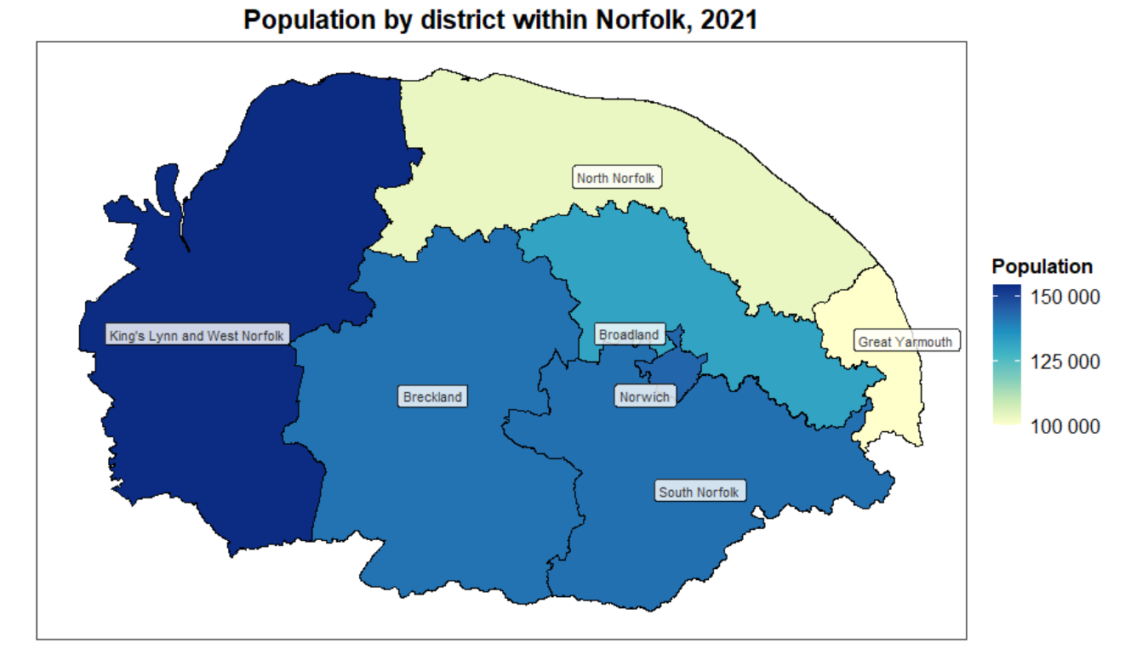
Population by district
 | Population (estimate) | Population density*
Breckland | 141,500 | 108
Broadland | 131,700 | 239
Great Yarmouth | 99,800 | 573
King’s Lynn and West Norfolk | 154,300 | 107
North Norfolk | 103,000 | 107
Norwich | 144,000 | 3,690
South Norfolk | 141,900 | 156
Norfolk | 916,200 | N/A
England | 56,489,800 | N/A
*The number of residents per square kilometre.
North Norfolk’s population is around 103,000 residents.
North Norfolk has the lowest population density along with King’s Lynn and West Norfolk, of around 107 residents per square kilometre.
Source: How the population changed where you live, Census 2021 – ONS & Build a custom area profile - Census 2021, ONS

Slide 5
Population by age by district
 | Population (2021 Census) | Aged under 15 years % | Aged 15 to 64 years % | Aged 65 years and over %
Breckland | 141,500 | 15.7% | 59.4% | 25.0%
Broadland | 131,700 | 15.1% | 59.0% | 25.9%
Great Yarmouth | 99,800 | 16.0% | 60.0% | 24.0%
King’s Lynn and West Norfolk | 154,300 | 15.5% | 58.6% | 25.9%
North Norfolk | 103,000 | 12.5% | 54.0% | 33.5%
Norwich | 144,000 | 15.2% | 69.9% | 14.9%
South Norfolk | 141,900 | 16.3% | 59.4% | 24.3%
Norfolk | 916,200 | 15.3% | 60.3% | 24.4%
England | 56,489,800 | 17.4% | 64.2% | 18.4%
Norfolk has an older population than England overall (24.4% of the Norfolk population are aged 65+ compared to 18.4% for England as a whole).
North Norfolk has the lowest number of residents aged under 15 years (12.5%) and aged 15 to 64 years (54%) out of all the districts, as well as being lower than the Norfolk average (15.3% and 24.4%).
However, North Norfolk has more residents aged 65 years and over (33.5%) than the Norfolk (24.4%) and England (18.4%) average.
Source: How the population changed where you live, Census 2021 – ONS & Build a custom area profile - Census 2021, ONS

Slide 6
Population change
 | Population (2021 Census) | Overall % change (vs. 2011 Census) | Aged under 15 years % change (2021 vs. 2011) | Aged 15 to 64 years % change (2021 vs. 2011) | Aged 65 years and over % change (2021 vs. 2011)
Breckland | 141,500 | 8.4% | 4.4% | 3.6% | 25.8%
Broadland | 131,700 | 5.7% | 2.2% | 0.6% | 22.6%
Great Yarmouth | 99,800 | 2.6% | 0.4% | -1.7% | 17.8%
King’s Lynn and West Norfolk | 154,300 | 4.6% | 3.8% | -0.1% | 17.9%
North Norfolk | 103,000 | 1.5% | -4.0% | -5.6% | 17.8%
Norwich | 144,000 | 8.7% | 6.3% | 8.6% | 10.6%
South Norfolk | 141,900 | 14.4% | 11.8% | 9.7% | 30.1%
Norfolk | 916,200 | 6.8% | 4.0% | 2.7% | 20.9%
England | 56,489,800 | 6.6% | 5.0% | 3.6% | 20.1%
Norfolk has seen a 6.8% increase in population between the 2011 Census and 2021 Census, compared to 6.6% for England.
North Norfolk has seen a 1.5% increase in population between the 2011 Census and 2021 Census, compared to 6.6% for England.
  Population change (2021 vs. 2011):
    Population under 15 years has decreased by -4.0%
    Population aged 15 to 64 years has decreased by -5.6%
    Population aged 65 years and over has increased by 17.8%
North Norfolk has the biggest decreases in population for residents under 15 years and aged 15 to 64 years than any other Norfolk district.
Source: Build a custom area profile - Census 2021, ONS & Norfolk Population Overview August 2023 (norfolkinsight.org.uk)

Slide 7
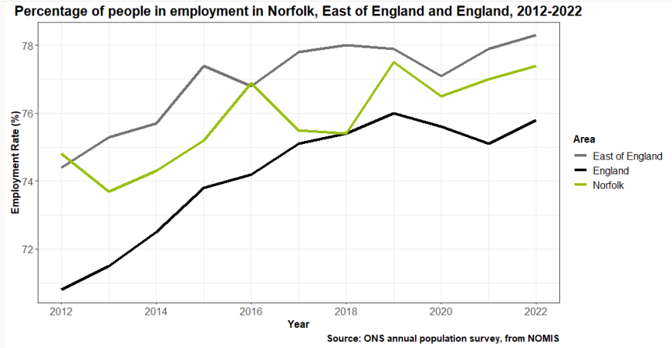
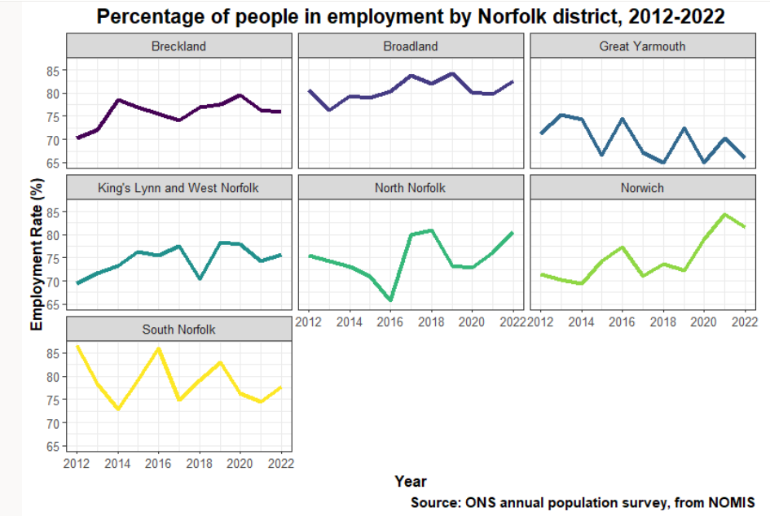
Employment rate
The latest data from 2022 puts Norfolk at 77.4% employment compared to 78.3% regionally and 75.8% nationally. Additionally, all areas are undergoing an overarching, increasing trend in employment rates after a relative dip in 2020/21 – likely due to the Covid-19 pandemic.
Historically and presently Norfolk’s employment rate tends to lie between the regional (East of England) and national rates.
North Norfolk had a slight drop in employment from 2014 to 2016, and in 2020, otherwise has been on an upward and constant trend, similar to other districts except for Great Yarmouth.
Source: Norfolk Population Overview August 2023 (norfolkinsight.org.uk)

Slide 8
Gross median weekly pay (workplace) by district
Workplace gross median weekly pay refers to median
earnings in pounds for employees working in the area.
As of 2022, as place to work, North Norfolk has a gross weekly median pay of £586.60.
Gross weekly median pay for North Norfolk has gradually increased from 2018, however remains just below the Norfolk median.
None of the districts are as high as, or above the England median.
Source: annual survey of hours and earnings - https://www.nomisweb.co.uk/ (taken February 2022)

Slide 9
Gross median weekly pay (residents) by district
Resident gross median weekly pay refers to median
earnings in pounds for employees living in the area.
North Norfolk has the lowest resident gross median pay of all the districts (£578.70).
North Norfolk is below the Norfolk average (£600), and the England average (£645.80).
None of the districts are as high as, or above the England median.
Source: annual survey of hours and earnings - https://www.nomisweb.co.uk/ (taken February 2022)

Slide 10
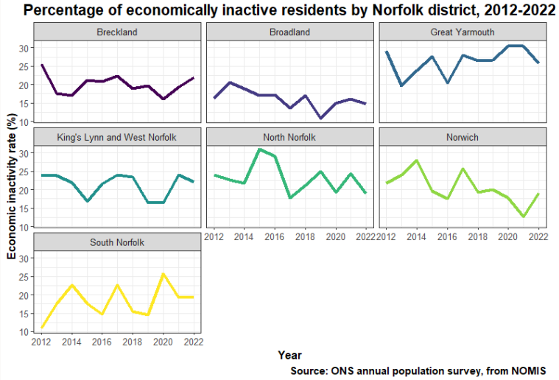
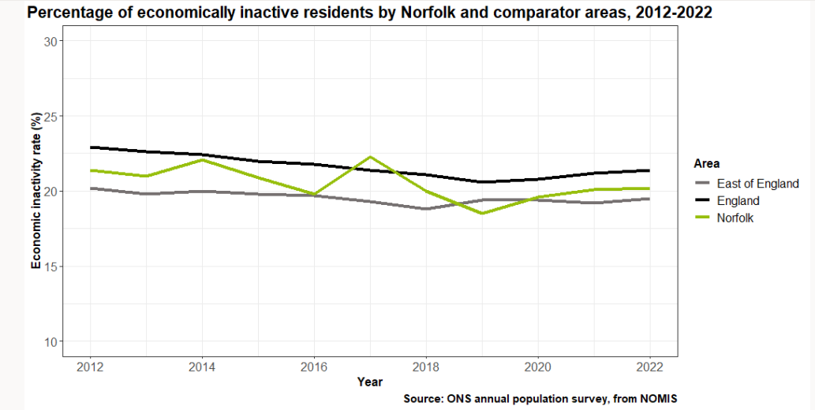
Economic inactivity
Economic inactivity is a measure of those individuals that are unemployed and have not sought work within the past 4 weeks, and/or are unable to start work within the next 2 weeks. In recent years Norfolk has seen lower levels of economic inactivity than England, but higher levels when compared to the East of England.
The left hand chart shows the percentage of economically inactive persons in Norfolk, East of England, and England, from 2012 to 2022. 20.2% of 16-64 year olds were classed as economically ‘inactive’ in 2022 in Norfolk compared to 19.5% in the East of England and 21.4% in England.
The chart on the right show the breakdown of economic inactivity by Norfolk district over the same period (2012-2022). In 2022 economic inactivity was highest in Great Yarmouth (25.7%) and King’s Lynn and West Norfolk (22.1%).
North Norfolk’s inactivity has been on a relatively constant and downward trend, being one of the lowest in Norfolk (19.0%).
Source: annual population survey - https://www.nomisweb.co.uk/ (taken November 2023)

Slide 11
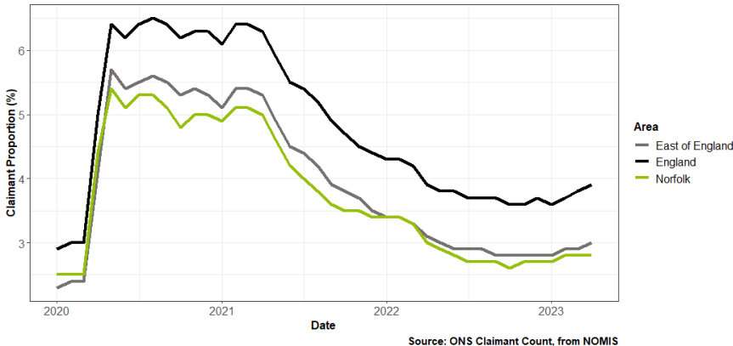
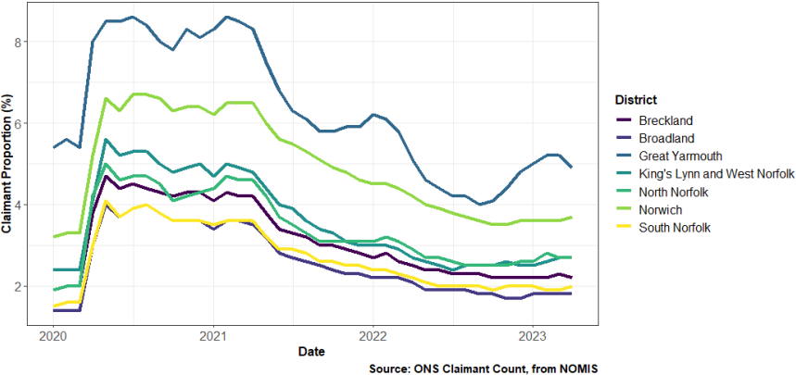
Claimant count
Proportion of residents aged 16-64 claiming JSA and UC in Norfolk, East of England and England, 01/2020 to 04/2023
Proportion of residents aged 16-64 claiming JSA and UC by Norfolk district, 012/2020 to 04/2023
North Norfolk
The monthly plot shows a sharp increase in claimants (the % of residents aged 16-64 who are claiming either Job Seekers Allowance, JSA, or Universal Credit, UC) in all areas at the beginning of the Covid-19 pandemic. These increased rates continue until early/mid-2021 when they start declining. After a period of relatively constant proportions, all areas have increased slightly in 2023.
Both Norfolk and the East of England have remained below the national average for the entire period. Norfolk’s claimant rate as of April 2023 was 2.8% compared to 3.9% nationally and 3% regionally.
This chart shows the same metric for the districts within Norfolk. ​
North Norfolk had a sharper increase in 2020 at the beginning of the pandemic, but not as
high as many other districts. Only South Norfolk, Broadland and Breckland sit under North
Norfolk’s proportions.​
North Norfolk has seen a gradual decline and levelling off in claimant percentage since
early/mid-2021 along with all districts except Great Yarmouth.
Source: Norfolk Population Overview August 2023 (norfolkinsight.org.uk)

Slide 12
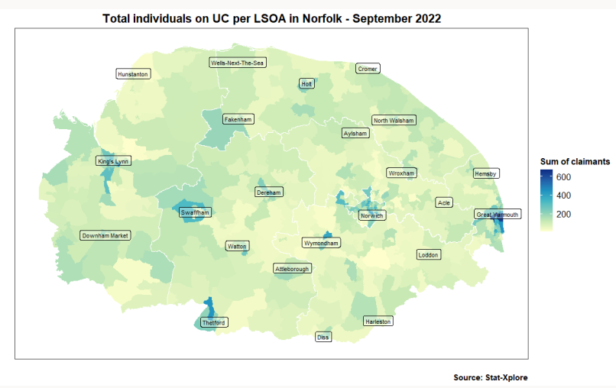
Claimant count continued
This map shows a lower super output area (LSOA) map of individuals receiving UC for Norfolk in August 2022, with areas shaded blue representing areas with a greater than average number.
A light green shaded LSOA represents one with the mean average number of UC recipients of all LSOAs, which in August 2022 was 127.
Areas shaded light yellow are those with lower than average numbers of UC recipients. This illustrates areas with the most UC claimants and helps to give a picture of the levels of hardship being experienced across the county.
As we might expect there is more residents claiming Universal Credit in urbanised areas.
As shown larger urban centres have higher numbers of UC claimants which are not located in North Norfolk. However, the town of Holt is a hotspot.
Source: Hardship in Norfolk Analysis using Universal Credit Data - Updated Version Refreshed October 2022 (norfolkinsight.org.uk)

Slide 13
Population living in most deprived IMD decile by district
Overall, 14.9% of the Norfolk population (approximately 136,400 residents) live in areas that are in IMD decile 1 or 2 – areas that are in the 20% most deprived areas of England.
2.6% of North Norfolk’s population live in areas that are in IMD decile 1 or 2.
Compared to other districts, the proportions are higher in Great Yarmouth and Norwich where around four in every 10 people live in LSOAs that are classed as the 20% most deprived areas of the country. ​
Source: Mid-209 population estimates Estimates of the population for the UK, England, Wales, Scotland and Northern Ireland - Office for National Statistics (ons.gov.uk) & “File 7” from English indices of deprivation 2019 - GOV.UK (www.gov.uk)

Slide 14
Percentage population living in each IMD decile by district
The table shows the percentage of the population in each district who live in LSOAs in each IMD decile.
None of North Norfolk’s residents live in IMD decile 1 and 10
16.5% of North Norfolk’s residents live in IMD deciles 2 and 3.
North Norfolk has the highest proportion of people living in LSOAs in IMD deciles 4 (25.9%), 5 (27.3%) and 6 (21.1%).
Note: these numbers are calculated using 2019 ONS mid-year estimates and the IMD decile of each LSOA. In this dataset the total Norfolk population used is 907,760.
 | IMD decile 1 | IMD decile 2 | IMD decile 3 | IMD decile 4 | IMD decile 5 | IMD decile 6 | IMD decile 7 | IMD decile 8 | IMD decile 9 | IMD decile 10
Breckland | 1.8% | 8.6% | 10.7% | 6.9% | 24.5% | 21.6% | 11.2% | 9.9% | 4.8% | 0.0%
Broadland | 0.0% | 0.0% | 0.0% | 4.6% | 11.5% | 14.8% | 16.5% | 18.4% | 21.8% | 12.5%
Great Yarmouth | 27.2% | 13.0% | 13.7% | 8.6% | 10.6% | 15.4% | 5.2% | 2.6% | 3.7% | 0.0%
King’s Lynn and West Norfolk | 7.9% | 7.3% | 16.2% | 17.7% | 24.3% | 13.2% | 4.6% | 2.0% | 3.9% | 2.8%
North Norfolk | 0.0% | 2.6% | 13.9% | 25.9% | 27.3% | 21.1% | 5.8% | 1.7% | 1.9% | 0.0%
Norwich | 19.4% | 19.5% | 9.2% | 17.6% | 2.4% | 7.9% | 3.5% | 7.1% | 3.1% | 10.3%
South Norfolk | 0.0% | 0.0% | 0.0% | 10.1% | 10.4% | 17.0% | 22.3% | 17.2% | 10.3% | 12.7%
Source: Mid-209 population estimates Estimates of the population for the UK, England, Wales, Scotland and Northern Ireland - Office for National Statistics (ons.gov.uk) & “File 7” from English indices of deprivation 2019 - GOV.UK (www.gov.uk)

Slide 15
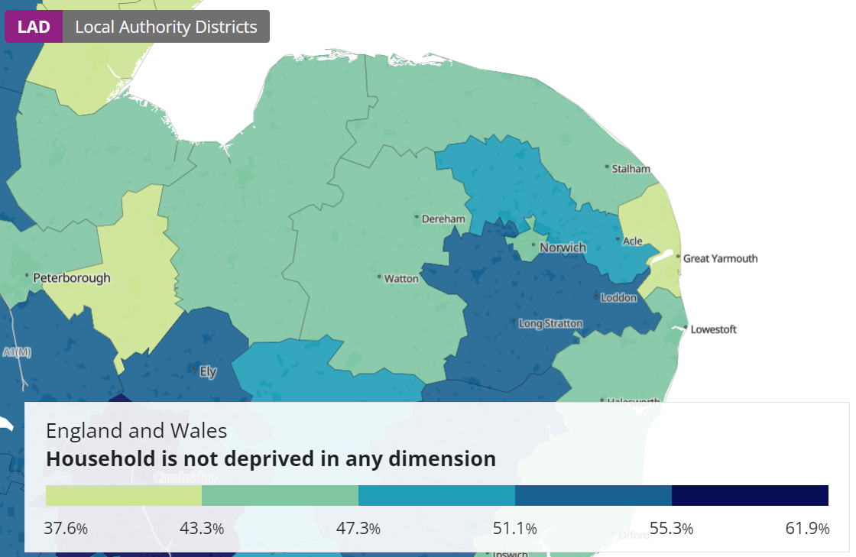
Household deprivation
North Norfolk has a higher percentage of households that
are classed as ‘deprived in at least one dimension’ (55.6%)
compared to Norfolk (54.1%) and England (51.6%).
More information can be found here:
Households by deprivation dimensions - Office for National Statistics
 | Percentage of households who have at least one dimension of deprivation
Breckland | 54.5%
Broadland | 49.0%
Great Yarmouth | 61.8%
King’s Lynn and West Norfolk | 56.0%
North Norfolk | 55.6%
Norwich | 55.0%
South Norfolk | 48.3%
Norfolk* | 54.1%
England* | 51.6%
*calculated using all data from lower tier local authorities
Source: Build a custom area profile - Census 2021, ONS

Slide 16
Fuel poverty
In 2020, 15.6% of households in Norfolk were classed as in fuel poverty (using the Low Income/Low energy Efficiency or LILEE model), compared to 13.2% in England.
North Norfolk has a higher proportion of households in fuel poverty (16.3%) compared to Norfolk (15.6%) and England (13.2%). ​
These figures are before the cost of living crisis began in 2021, so there is a possibility these figures are now higher for all districts. ​
Source: Percentage of households in fuel poverty - Low Income/Low energy Efficiency (LILEE) | Data Explorer - Norfolk Insight

Slide 17
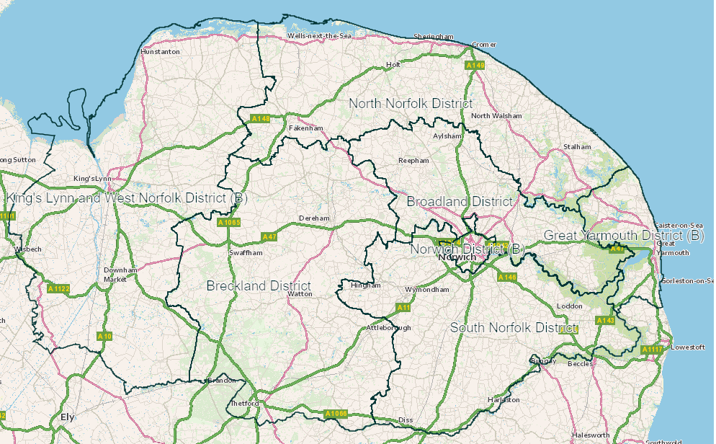
Student population
North Norfolk 3.5%
Overall, 5.5% of Norfolk’s population is classed a full-time students, compared to 7.1% in England overall.
3.5% of North Norfolk’s population are classed as full-time students aged 16 and over, the lowest of all the districts. ​
North Norfolk ranks 317th out of 318 of all local authorities for the proportion of “all usual residents aged 16 and over” that are “full-time students”.​
Along with Breckland and King’s Lynn and West Norfolk, North Norfolk is one of the seven lowest-tier ranked local authorities. ​
King’s Lynn & West Norfolk 3.9%
Broadland 4.4%
Great Yarmouth 5.1%
Norwich 12.7%
Breckland 4.1%
South Norfolk 4.5%
Source: 2021 Census (RM020) - https://www.nomisweb.co.uk/ (taken 5th January 2024), calculated using figures shown and “full time student” cohorts as a proportion of “all usual residents aged 16 years and over in households”. It should be noted that students were given guidance on how to complete the Census, more information is here: Students: Census 2021 - Office for National Statistics (ons.gov.uk)

Slide 18
Skills and qualifications by district
While some of Norfolk’s districts are above or close to the county overall, none reach the national percentage for 2021. Some districts have a relatively low percentage of people with level 4+ qualifications when compared to England as a whole.
North Norfolk has 33.0% of people with level 4+ qualifications in 2021, a slight decrease since 2020 and 2019.​
North Norfolk is almost the same as the Norfolk percentage (33.1%) but doesn't reach the England percentage (43.2%) in 2021. ​
None of the districts had the same or higher percentages than the England percentage in 2021.
Source: Annual Population Survey - https://www.nomisweb.co.uk/ (taken 21st November 2023)

Slide 19
Other qualifications
The chart shows the percentage of people in each region with each level of qualification for January 2021 to December 2021 with England and the East of England for comparison.
The percentage of residents in North Norfolk with NVQ1+ are above the averages for Norfolk, East of England and England. However, the percentage of residents with NVQ3+ are all below the averages for Norfolk, East of England and England.
Source: Annual Population Survey - https://www.nomisweb.co.uk/ (taken 21st November 2023)

Slide 20
No qualifications
2021 data shows 7% of people aged 16-64 in Norfolk had no qualifications, this compares to 6.4% in England as a whole and 5.8% in the East of England region for the same period.
North Norfolk has a lower percentage of people aged 16-64 with no qualifications (4.5%) compared to England (6.4%), East of England (5.8%) and Norfolk (7.0%).
North Norfolk has the second lowest percentage, with South Norfolk the lowest (3.1%).
East of England
Source: Annual Population Survey - https://www.nomisweb.co.uk/ (taken 21st November 2023)

Slide 21
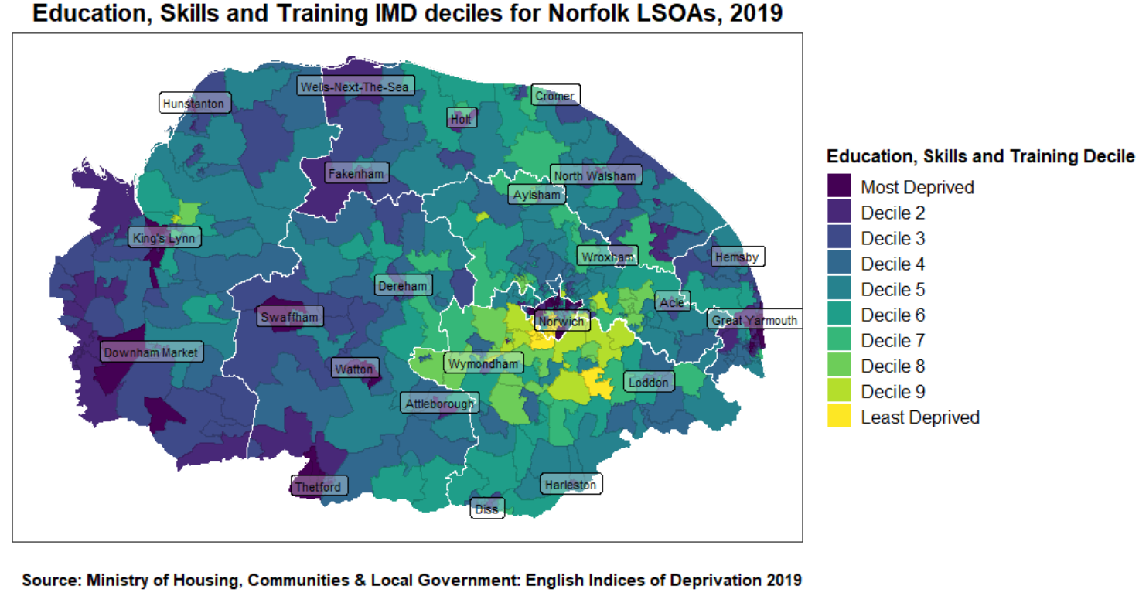
IMD – Education, Skills and Training
Within the Education domain of IMD there is an Adult Skills sub-domain. The above visuals show the proportion of LSOAs, within a local authority district, that fall within the most deprived 10% nationally, for the Adult Skills sub-domain.
North Norfolk has no LSOAs within the most deprived 10% nationally for Adult Skills.
Source: IMD - Adult Skills Sub-domain - proportion of LSOAs in most deprived 10% nationally in Breckland | LG Inform (local.gov.uk)

Slide 22
Adult education rate/POLAR4 quintile by district
In North Norfolk, 22.3% of the adult population held higher education qualifications in 2020.
“The participation of local areas (POLAR) classification groups areas across the UK based on the proportion of young people who participate in higher education.
It looks at how likely young people are to participate in higher education across the UK and shows how this varies by area.
POLAR classifies local areas into five groups - or quintiles - based on the proportion of young people who enter higher education aged 18 or 19 years old.
Quintile one shows the lowest rate of participation. Quintile five shows the highest rate of participation.” Source: Office for Students
 | Mode average (i.e. most common at MSOA level) POLAR4 quintile
Breckland | Quintile 2 (7 of 17 MSOAs)
Broadland | Quintile 2 / Quintile 3 (both 6 of 18 MSOAs)
Great Yarmouth | Quintile 1 (7 of 13 MSOAs)
King’s Lynn and West Norfolk | Quintile 1 (11 of 19 MSOAs)
North Norfolk | Quintile 3 (7 of 14 MSOAs)
Norwich | Quintile 1 (8 of 14 MSOAs)
South Norfolk | Quintile 4 (6 of 15 MSOAs)
Source: https://www.officeforstudents.org.uk/data-and-analysis/young-participation-by-area/get-the-postcode-data/

Slide 23
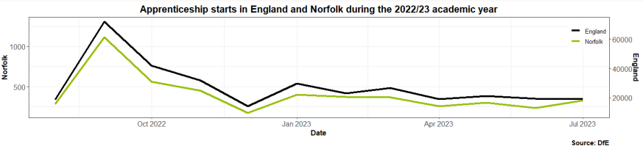
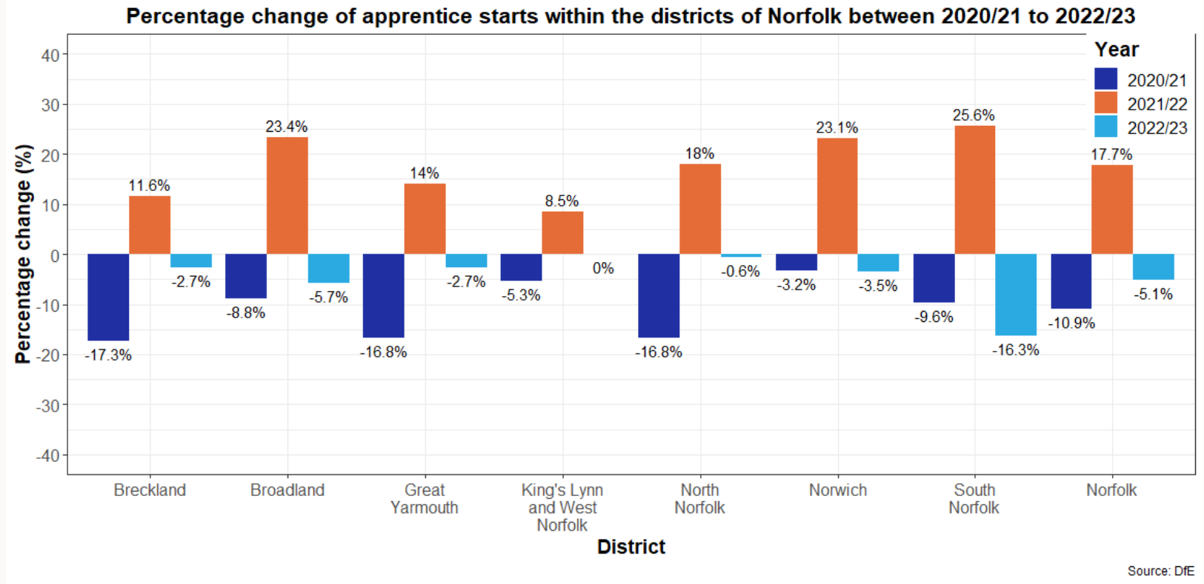
Apprenticeship starts
Norfolk’s apprenticeship starts have followed the same trend as England overall.
2022/23 has seen lower numbers of starts in comparison to 2021/22, and this trend is also reflected across all the districts.
Source: Apprenticeships - Norfolk Current Academic Year - Power BI

Slide 24
Business

Slide 25
Key sector and cluster definitions
Definitions
Advanced Manufacturing and Engineering – This sector includes industries involved in the use of cutting-edge technology to improve products and processes. It encompasses high-precision manufacturing, automation, robotics, and materials engineering to create innovative products and solutions.
Creative Sector – This sector includes industries that focus on the creation and distribution of products and services that are rooted in cultural, artistic, and design-oriented creativity. It encompasses activities such as advertising, architecture, arts, crafts, design, fashion, film, music, performing arts, publishing, and software development.
Ports and Logistics – This sector involves the management of the movement of goods and services, including the operation of ports, warehousing, transportation, distribution, and supply chain management. It ensures the efficient flow of products from origin to destination.
Space - This sector includes activities related to space exploration, satellite technology, space research, and the development of related technologies and infrastructure. It encompasses aerospace engineering, satellite communications, and space missions.
Visitor Economy - This sector involves industries that support tourism and travel, including hospitality, accommodation, attractions, events, and services that cater to tourists and visitors. It plays a key role in regional economic development by attracting visitors and their spending.
Construction and Development - This sector includes industries involved in the planning, design, construction, and maintenance of buildings and infrastructure. It encompasses residential, commercial, industrial, and civil engineering projects, as well as real estate development.
Financial Services and Insurance - This sector comprises industries that manage money, including banking, investment, insurance, real estate, and financial technology. It provides services such as lending, asset management, financial planning, and risk management.

Slide 26
Key sector and cluster definitions – (continued)
Definitions
Digital Tech - This sector encompasses industries that develop and utilize digital technologies, including software development, IT services, cybersecurity, data analytics, artificial intelligence, and telecommunications. It focuses on the innovation and application of digital solutions.
Health and Social Work– This sector includes industries that provide medical care, health services, and social support. It encompasses hospitals, clinics, healthcare professionals, social workers, and organizations that offer support for mental health, elderly care, and community services.
Agri-Food Tech - This sector involves the application of technology to agriculture and food production. It includes activities such as precision farming, biotechnology, food processing, supply chain management, and sustainable agriculture practices to improve productivity and efficiency in the food industry.
Energy - This sector includes industries involved in the production, distribution, and management of energy. It encompasses traditional energy sources like oil, gas, and coal, as well as renewable energy sources such as wind, solar, hydroelectric, and geothermal power.
Life Sciences - This sector includes industries related to the study of living organisms and life processes. It encompasses biotechnology, pharmaceuticals, medical devices, healthcare, and environmental sciences. It focuses on research, development, and the application of biological and medical knowledge to improve health and the environment.
The above definitions are not intended to replace or replicate strict Standard Industrial Classification (SIC) sector definitions, while specific SIC sector codes definitions will be composite elements within these strategic opportunities, they are deliberately intended to be cross-cutting and are understood to often operate in support of one another - fundamentally underpinning the
over-arching objective of clean growth.

Slide 27
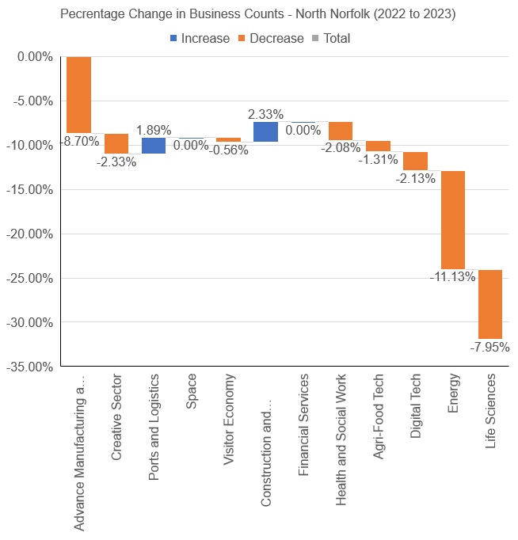
Business Counts
The Visitor Economy has the highest share of business counts within the businesses in North Norfolk (24.89%) and the Space sector being the smallest (0.08%).
The Construction and Development sector demonstrated the highest increase in the business counts by 2.33% from 2022-2023, followed by Ports and Logistics sector at 1.89%.
The Energy sector showed the most decrease (-11.13%) in the number of businesses within Norfolk, followed by Advanced Manufacturing and Engineering sector at -8.7%
North Norfolk in higher than England in the Agri-food Tech sector by 6.67% in the business count share and lower than the national figures in Digital Tech sector by 7.23%.

Slide 28
Distribution of clusters between districts
Foundational Sectors | Highest share of business units | Lowest share of business units
Advance Manufacturing and Engineering | Breckland | Norwich
Creative Sector | Norwich | Great Yarmouth
Ports and Logistics | Norwich | Great Yarmouth
Space | Broadland | Great Yarmouth
Visitor Economy | Norwich | Broadland
Construction and Development | King's Lynn and West Norfolk | Great Yarmouth
Financial Services | Norwich | Great Yarmouth
Health and Social Work | Norwich | Great Yarmouth
Agri-Food Tech | Breckland | Great Yarmouth
Digital Tech | Norwich | Great Yarmouth
Energy | Breckland | Broadland
Life Sciences | South Norfolk | Great Yarmouth
North Norfolk has the second lowest number of business units (3576 units) in Norfolk, with the lowest number in Great Yarmouth (2302) in 2023.
North Norfolk’s highest proportion of business units are Visitor Economy (890 business units) followed by Agri-Food Tech sector (779 units).
The Space (5), Energy (41) and Life Sciences (61) sectors have the least number of business counts in North Norfolk.
Source: Nomis - Official Census and Labour Market Statistics (nomisweb.co.uk) - UK Business Counts (local units)

Slide 29
Gross Value Added (GVA)
Gross value added (GVA), which is the value generated by any unit engaged in the production of goods and services.
Agri-Food Tech sector has the highest GVA in North Norfolk (£0.53 B) occupying a share of 20%, followed by Visitor Economy at 19%.
Space sector occupies the least GVA share with a value of £0.5 million followed by Financial Services and Insurances sector (1%) and Life-Sciences at 2%.
The GVA per head (calculated by GVA per number of jobs) is the highest in the Energy sector (£308,800), followed by Digital-Tech sector (£39,500).
The GVA per head is least in the Space sector with a value of £16,000, followed by Visitor Economy at £17,500.
Source: Lightcast

Slide 30
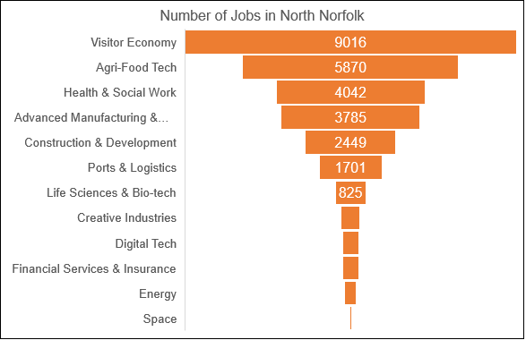
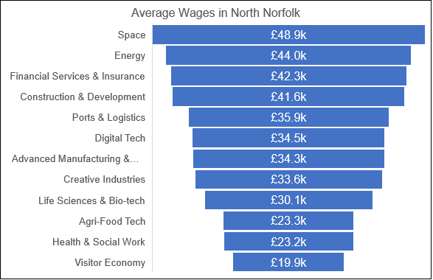
Jobs and Average Wages
The Space sector provides the highest average wages (£48,900k) among the foundational sectors, followed by Energy (£44,000).
The Visitor Economy sector has the lowest average wages in North Norfolk (£19,900).
The Space sector has the lowest number of jobs available in North Norfolk (34 jobs), followed by Energy at 321 jobs.
Visitor Economy sector has the highest number of jobs available in North Norfolk (9016 jobs), followed by Agri-food Tech at 5870.
Source: Lightcast

Slide 31
Location Quotient and Competitive Effect
Competitive effect indicates how much of the job change within a given region is the result of some unique competitive advantage of the region. A positive competitive effect suggests that the region has some competitive edge or unique factors driving job growth beyond national or industry trends.
Agri-Food Tech sector has the highest location quotient (2.15) followed by Visitor Economy sector (1.89) in North Norfolk.
Digital-Tech sector has the lowest LQ (0.22) indicating the lack of specialization in the industry in North Norfolk.
The Visitor Economy has the highest competitive effect (1366) among the foundational sectors, followed by Agri-Food Tech (442).
The Advanced Manufacturing and Engineering sector has the lowest competitive effect (-1410) in North Norfolk.
A location quotient (LQ) is an analytical statistic that measures a region's industrial specialization relative to a larger geographic unit. It is a ratio that compares the concentration of a particular industry or sector in a region to the national average. An LQ greater than 1 indicates that the industry has a higher concentration in the region than nationally, suggesting specialization.
Source: Lightcast

Slide 32
Percentage Change in Jobs and Job Forecast
The Visitor Economy sector has the highest percentage increase in the number of jobs among the foundational sectors (+10.4%), followed by Space sector (+7.2%) from 2022-2023 in North Norfolk.
Creative Industries (-2.5%) and Energy(-1.8%) sectors faced the highest decline in the number of jobs from 2022 to 2023.
The Space(+26.3%) sector has the highest forecasted percentage increase in the number of jobs among the foundational sectors, followed by Financial Services and Insurance sector (+25.3%) for the period of 2023 to 2033.
Health and Social Work and Advanced Manufacturing and Engineering sector had a decline (-0.3% ) in the percentage of forecasted jobs from 2023 to 2033.
(The percentage change of job forecasting was obtained from Lightcast)
Source: Lightcast (The percentage change of job forecasting was obtained from Lightcast)

Slide 33
Norfolk business size by District
The districts show a similar picture to Norfolk and England overall, including North Norfolk.
North Norfolk has 4,980 businesses as of 2023, with 88% of these micro businesses.
 | Business count (2023) | Micro (0-9) | Small (10-49) | Medium (50-249) | Large (250+)
Broadland | 6,080 | 89% | 9% | 1% | 0.3%
Breckland | 5,475 | 88% | 9% | 2% | 0.4%
Great Yarmouth | 3,520 | 87% | 11% | 2% | 0.2%
King’s Lynn and West Norfolk | 6,650 | 89% | 10% | 1% | 0.2%
North Norfolk | 4,980 | 88% | 11% | 1% | 0.1%
Norwich | 6,500 | 84% | 12% | 2% | 0.7%
South Norfolk | 6,555 | 90% | 8% | 1% | 0.3%
Norfolk | 39,760 | 88% | 10% | 2% | 0.3%
East of England | 308,685 | 90% | 9% | 2% | 0.4%
England | 2,737,105 | 89% | 9% | 2% | 0.4%
East of England
Source: Nomis - Official Census and Labour Market Statistics (nomisweb.co.uk) – UK Business Counts (enterprises)

Slide 34
Business change
North Norfolk has seen a 7% business growth, which is below the Norfolk average.
North Norfolk is 14% under the East of England and 16% under the England average. ​
East of England
Source: Nomis - Official Census and Labour Market Statistics (nomisweb.co.uk) - UK Business Counts (local units)

Slide 35
Business ‘births’ and survival rates
Births Of New Enterprises | 2021 | 2022
Norfolk | 3,585 | 3,270
Breckland | 485 | 470
Broadland | 490 | 445
Great Yarmouth | 445 | 330
King’s Lynn and West Norfolk | 530 | 475
North Norfolk | 390 | 350
Norwich | 710 | 675
South Norfolk | 535 | 525
In 2021 in North Norfolk, 390 new enterprises were ‘born’ and 96.2% of these enterprises ‘survived’ their first year of business.
1-year survival rates were similar across the board.
The 3-year survival rate (based on business ‘births’ in 2019) was higher in North Norfolk than England, but lower than the Norfolk average overall.
When looking at 5-year survival rates (for business births in 2017), North Norfolk achieved better survival rates (50.8%) than England (39.4%) and Norfolk (40.1%).
Survival Of Newly Born Enterprises (2021 business births) | 1-year survival
Norfolk | 93.9%
Breckland | 93.8%
Broadland | 94.9%
Great Yarmouth | 93.3%
King’s Lynn and West Norfolk | 94.3%
North Norfolk | 96.2%
Norwich | 93.0%
South Norfolk | 92.5%
England | 93.5%
Survival Of Newly Born Enterprises (2019 business births) | 1-year survival | 2-year survival | 3-year survival
Norfolk | 94.5% | 77.5% | 62.5%
Breckland | 93.2% | 75.0% | 62.5%
Broadland | 96.4% | 81.9% | 65.1%
Great Yarmouth | 95.5% | 77.3% | 59.1%
King’s Lynn and West Norfolk | 94.8% | 76.0% | 63.5%
North Norfolk | 93.0% | 77.2% | 61.4%
Norwich | 93.8% | 77.7% | 61.5%
South Norfolk | 95.1% | 77.5% | 63.7%
England | 94.7% | 74.5% | 55.9%
Survival Of Newly Born Enterprises (2017 business births) | 1-year survival | 2-year survival | 3-year survival | 4-year survival | 5-year survival
Norfolk | 93.8% | 76.0% | 52.7% | 45.3% | 40.1%
Breckland | 92.9% | 75.5% | 60.2% | 52.0% | 46.9%
Broadland | 93.3% | 62.5% | 52.5% | 45.8% | 41.7%
Great Yarmouth | 91.8% | 73.8% | 57.4% | 49.2% | 41.0%
King’s Lynn and West Norfolk | 95.8% | 81.1% | 63.2% | 53.7% | 49.5%
North Norfolk | 96.8% | 79.4% | 65.1% | 60.3% | 50.8%
Norwich | 94.0% | 81.4% | 34.4% | 28.8% | 24.7%
South Norfolk | 92.8% | 75.7% | 63.1% | 53.2% | 47.7%
England | 93.8% | 72.6% | 55.9% | 45.7% | 39.4%
Source: Business demography, UK - Office for National Statistics (ons.gov.uk)

Slide 36
Sole proprietors
Sole proprietor businesses account for 22% of the business base in North Norfolk. This is higher than the national (14%) and regional (also 14%) averages.
Source: Nomis - Official Census and Labour Market Statistics (nomisweb.co.uk) - UK Business Counts (enterprises)

Slide 37
High Growth enterprises
High Growth enterprises definition/method:
“There are several different methods of measuring high growth. The following definition has been used for this analysis:
All enterprises with average annualised growth greater than 20% per annum, over a three year period. Growth can be measured by the number of employees or by turnover. For this analysis growth has been measured using employment.
It is also recommended that a meaningful size threshold be set to avoid the growth of small businesses distorting any results. Eurostat have provisionally set a starting threshold of 10 employees.
In order to calculate the growth of units, it is not necessary to check the change in employee numbers or turnover from one year to the next over a three year period. Instead it is sufficient to compare the population of active enterprises in year xx-3 with those in year xx.
In practice, average annualised growth of 20% per annum over three years would be equal to 72.8% growth from xx-3 to year xx.
We are unable to isolate and remove all cases where data has grown due to a merger or a takeover. These cases are isolated and we do not expect them to have a big impact on the data.”
North Norfolk has the second highest proportion of ‘High Growth’ enterprises in 2022 (0.50%) which is higher than the Norfolk, East of England and England average.
Source: Business demography, UK - Office for National Statistics (ons.gov.uk)

Slide 38
Norfolk’s employment base and change
The number of people employed in Norfolk’s rose from 377,000 in 2015 to 393,300 in 2022 – a 4.5% increase.
Health (15%), retail (11%) and accommodation & food services (10%) account for over a-third of the Norfolk employment base.
North Norfolk had a percentage change of 6.3%, which is higher than the Norfolk average (4.5%) but lower than the East of England (7.9%) and England (8.4%) average.
 | Percentage employment change by area (2015-2022)
Norfolk | 4.5%
Breckland | 0.0%
Broadland | 8.7%
Great Yarmouth | -2.6%
King’s Lynn and West Norfolk | 9.1%
North Norfolk | 6.3%
Norwich | -2.3%
South Norfolk | 15.7%
East of England | 7.9%
England | 8.4%
Lincolnshire | 7.1%
Suffolk | 6.4%
Cornwall | 10.7%
Somerset | 5.8%
East Sussex | -0.5%
Cambridgeshire & Peterborough | 8.3%
East of England
Source: Nomis - Official Census and Labour Market Statistics (nomisweb.co.uk)

Slide 39
Productivity (GVA)
The North Norfolk region was responsible for over £1.6 billion in GVA in 2021.
The measure of GVA per hour worked shows that in 2020, North Norfolk was not more productive, on average, than the UK overall.
 | Regional GVA (current prices, £m) | GVA per hour worked (2020)
Breckland | £2,687 | £30.95
Broadland | £4,000 | £47.39
Great Yarmouth | £1,888 | £30.96
King’s Lynn and West Norfolk | £3,241 | £32.46
North Norfolk | £1,673 | £25.64
Norwich | £4,116 | £30.59
South Norfolk | £3,064 | £31.99
UK less Extra-Regio | N/A | £37.73
Source: Regional gross value added (balanced) by industry: local authorities by ITL1 region - Office for National Statistics (ons.gov.uk) & Subregional productivity: labour productivity indices by local authority district - Office for National Statistics (ons.gov.uk)

Slide 40
Indexed GVA per hour worked
With the UK indexed to 100, we can see how the Norfolk districts compare to the country in terms of GVA (£ per hour worked) between 2012 and 2021.
Aside from Broadland, North Norfolk, along with the other districts, has remained below the UK index.
North Norfolk is the lowest of all the districts.
This has been the same for the last 10 years.
Source: Subregional productivity in the UK - Office for National Statistics (ons.gov.uk) & Subregional productivity: labour productivity indices by local authority district - Office for National Statistics (ons.gov.uk)

Slide 41
GVA by sector
2021 (£ million) | Breckland | Broadland | Great Yarmouth | King's Lynn and West Norfolk | North Norfolk | Norwich | South Norfolk
All industries | 2,589 | 3,960 | 1,715 | 3,043 | 1,588 | 3,832 | 2,702
Production sector | 758 | 400 | 345 | 957 | 319 | 344 | 368
Agriculture, mining, electricity, gas, water and waste | 156 | 67 | 147 | 231 | 141 | 52 | 164
Manufacturing | 602 | 333 | 198 | 726 | 178 | 292 | 204
Manufacture of food, beverages, textiles and clothing | 176 | 113 | 13 | 262 | 65 | 47 | 49
Manufacture of wood, petroleum, chemicals and minerals | 262 | 88 | 32 | 249 | 36 | 111 | 47
Manufacture of metals, electrical products and machinery | 125 | 114 | 117 | 178 | 54 | 81 | 91
Other manufacturing, repair and installation | 39 | 18 | 35 | 36 | 23 | 53 | 17
Construction | 244 | 271 | 85 | 219 | 107 | 229 | 258
Construction of buildings | 67 | 100 | 14 | 44 | 40 | 33 | 39
Civil engineering | 71 | 17 | 14 | 26 | 16 | 57 | 60
Specialised construction activities | 106 | 154 | 56 | 148 | 51 | 139 | 159
Services sector | 1,587 | 3,288 | 1,285 | 1,867 | 1,162 | 3,259 | 2,077
Wholesale and retail trade; repair of motor vehicles | 283 | 280 | 150 | 292 | 158 | 481 | 290
Motor trades | 25 | 30 | 17 | 59 | 15 | 74 | 37
Wholesale trade | 83 | 89 | 26 | 67 | 37 | 98 | 125
Retail trade | 175 | 161 | 107 | 166 | 106 | 309 | 128
Transportation and storage | 89 | 34 | 37 | 45 | 34 | 96 | 44
Land, water and air transport | 32 | 8 | 12 | 21 | 22 | 40 | 20
Warehousing, transport support, postal and courier activities | 57 | 26 | 25 | 24 | 12 | 56 | 25
Accommodation and food service activities | 57 | 57 | 125 | 108 | 99 | 124 | 63
Information and communication | 21 | 77 | 33 | 29 | 18 | 163 | 41
Financial and insurance activities | 14 | 1,742 | 13 | 16 | 11 | 104 | 13
Real estate activities | 385 | 481 | 217 | 460 | 411 | 475 | 446
Owner-occupiers' imputed rental | 316 | 350 | 189 | 395 | 349 | 235 | 369
Real estate activities, excluding imputed rental | 70 | 131 | 28 | 65 | 61 | 240 | 78
Professional, scientific and technical activities | 93 | 88 | 89 | 67 | 43 | 289 | 109
Legal and accounting activities | 24 | 31 | 10 | 25 | 13 | 173 | 33
Head offices and management consultancy | 5 | 6 | 3 | 5 | 4 | 16 | 14
Architectural and engineering activities | 33 | 18 | 64 | 13 | 3 | 31 | 22
Other professional, scientific and technical activities | 30 | 33 | 11 | 24 | 22 | 69 | 40
Administrative and support service activities | 163 | 78 | 101 | 112 | 42 | 219 | 85
Rental and leasing activities | 66 | 21 | 47 | 34 | 9 | 27 | 11
Employment activities; tourism and security services | 67 | 21 | 35 | 51 | 12 | 134 | 22
Services to buildings and landscape activities | 16 | 13 | 4 | 20 | 9 | 38 | 20
Office administration and business support activities | 12 | 24 | 15 | 7 | 12 | 20 | 32
Public administration and defence | 150 | 78 | 57 | 229 | 68 | 441 | 144
Education | 156 | 149 | 128 | 194 | 120 | 472 | 177
Human health and social work activities | 116 | 171 | 259 | 263 | 85 | 241 | 596
Human health and residential care activities | 89 | 151 | 237 | 252 | 79 | 194 | 509
Social work activities | 27 | 20 | 22 | 11 | 5 | 46 | 87
Arts, entertainment and recreation | 25 | 19 | 50 | 27 | 35 | 79 | 24
Other service activities | 25 | 26 | 19 | 16 | 31 | 67 | 34
Membership organisations; repair of household goods | 6 | 9 | 1 | 1 | 14 | 45 | 7
Other personal service activities | 19 | 17 | 18 | 15 | 18 | 22 | 27
Activities of households | 9 | 8 | 6 | 10 | 7 | 9 | 9
Regional gross value added (balanced) by industry for Norfolk districts, in millions, 2021 data. This table shows a breakdown of GVA by industry and local authority.
GVA for North Norfolk was £1.59bn
‘Services’, ‘Real estate activities’ and ‘Owner-occupiers’ imputed rental’ are some of the greatest contributors to GVA in North Norfolk.
‘Production’ was also a high contributor to GVA in North Norfolk.
Source: TLH East of England edition from Regional gross value added (balanced) by industry: local authorities by ITL1 region - Office for National Statistics (ons.gov.uk)

Slide 42
Place

Slide 43
4G coverage
North Norfolk has the lowest 4G coverage of all the districts (80.8%).
4G Coverage has remained the same for North Norfolk in both 2021 and 2022.
The average of the 2022 figures is 90.8%, so we could infer that Norfolk as a whole has 90.8% 4G coverage from all operators.
This is up slightly from an average of 90.3% in 2021.
Source: Connected Nations 2022: data downloads – Ofcom – downloaded 29th November 2023

Slide 44
Wellbeing – life satisfaction
Life satisfaction scores in Norfolk have consistently remained above UK scores for the last 10 years.
Life satisfaction scores in North Norfolk are higher than the UK scores, along with Broadland, North Norfolk and Great Yarmouth.
Source: Annual Population Survey, Office for National Statistics
Question: Overall, how satisfied are you with your life nowadays? Where 0 is 'not at all satisfied' and 10 is 'completely satisfied'.

Slide 45
Wellbeing – a worthwhile life
Data for 2021/22 shows that Norfolk scores higher than the UK overall for feeling the ‘things’ people ‘do’ in life are ‘worthwhile’.
Six of the seven Norfolk districts, including North Norfolk, have ‘feeling worthwhile’ scores equal to, or above the UK overall.
Source: Annual Population Survey, Office for National Statistics
Question: Overall, to what extent do you feel the things you do in your life are worthwhile? Where 0 is 'not at all worthwhile' and 10 is 'completely worthwhile'.

Slide 46
Wellbeing – happiness
Happiness scores for Norfolk have remained in-line with the UK overall.
Data for 2021/22, shows that four of the seven Norfolk districts have higher happiness scores than the UK overall.
North Norfolk has the second lowest happiness scores of all the districts (7.35) which is also lower than the UK average.
Source: Annual Population Survey, Office for National Statistics
Question: Overall, how happy did you feel yesterday? Where 0 is 'not at all happy' and 10 is 'completely happy'.

Slide 47
Wellbeing – anxiety
Feelings of anxiety for Norfolk residents have been in-line with the UK overall.
North Norfolk, along with most other Norfolk districts, have lower anxiety scores than of the UK overall.
Source: Annual Population Survey, Office for National Statistics
Question: Overall, how anxious did you feel yesterday? Where 0 is 'not at all anxious' and 10 is 'completely anxious'

Slide 48
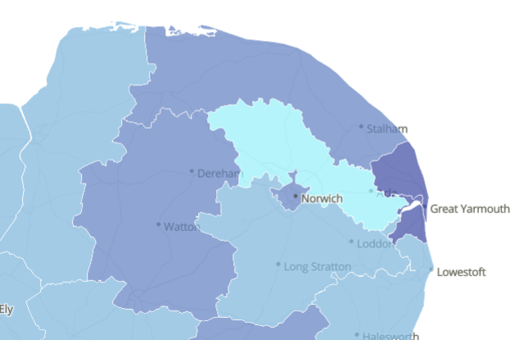

Loneliness
The map shows a measure of loneliness – the percentage of adults aged 16 and over reporting “often or always” feeling lonely – October 2020 to February 2021. Please note this data was gathered during the Covid-19 pandemic National lockdowns.
The percentages for each district are shown below:
Breckland 7.7%
Broadland 4.5%
Great Yarmouth 10.7%
KL & WN 6.3%
North Norfolk 8.5%
Norwich 8.4%
South Norfolk 6.8%
Great Britain 7.2%
Further context and links to other data sets has been provided by the ONS in the source link below.
Source: Mapping loneliness during the coronavirus pandemic - Office for National Statistics (ons.gov.uk)

Slide 49
Housing affordability
For this measure a lower ratio is a positive, therefore Norfolk's affordability of housing (in comparison to earnings) of 8.57 (for 2022) is less affordable than England (8.28).
In 2022, North Norfolk (10.43) has the highest ratio of all the districts, meaning it is the least affordable place for those who live there to buy a house.
North Norfolk has a higher ratio than Norfolk (8.57) and England (8.28).
Source: House price (existing dwellings) to residence-based earnings ratio - Office for National Statistics (ons.gov.uk)
A higher ratio indicates that on average, it is less affordable for a resident to purchase a house in their local authority district.

Slide 50
House prices
The average median price paid for a house in Norfolk for the year ending September 2022 was £262,300, compared to £275,000 for England.
The median price paid for a house in North Norfolk is £300,000, which is higher than the Norfolk and England average.
The median price paid for a house in North Norfolk increased by £60,000 between the year ending September 2018 and the year ending September 2022.
This increase is higher than England for the same period (£45,000).
Source: House price (existing dwellings) to residence-based earnings ratio - Office for National Statistics (ons.gov.uk)

Slide 51
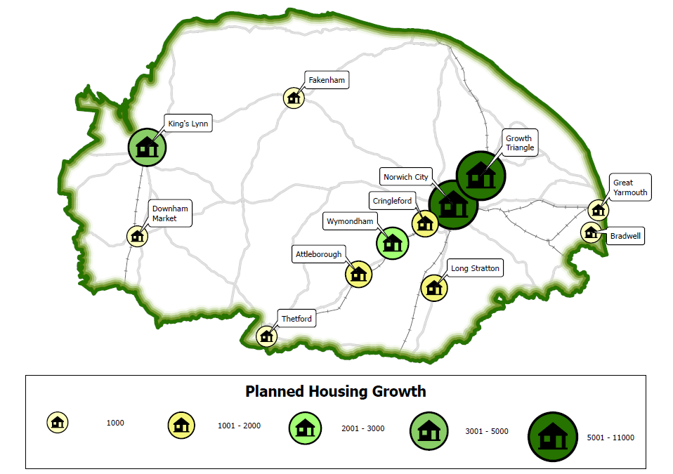
Planned housing
This map shows the planned housing in Norfolk– taken from several local plans. It shows housing growth along the ‘Cambridge Norwich Tech Corridor’.
North Norfolk key strategic housing sites have been identified from the following local plan:
  North Norfolk 2001 – 2025
North Norfolk have 8,025 houses planned, with 8,347 houses built since the Local Plans have been adopted.
The map doesn’t include all housing but shows the major sites. It should also be noted that it doesn’t account for what has been built since the start of the local plan period(s).
 | Local Plan period | Number of houses planned in the Local Plan period | Number of houses built since Local Plans adopted
Breckland | 2011-2036 | 15,298 | 6,081
Great Yarmouth | 2013-2030 | 5,303 | 2,489
King’s Lynn & West Norfolk | 2001-2026 | 16,500 | 11,471
North Norfolk | 2001-2025 | 8,025 | 8,347
Greater Norwich Local Plan (Broadland, Norwich and South Norfolk) | 2018-2036 | 45,000 | 23,684
Norfolk Total |  | 90,126 | 52,072
Source: Draft Norfolk Strategic Infrastructure Delivery Plan 2023

Slide 52
Gross disposable household income (GDHI) per head
Gross disposable household income (GDHI) is the amount of money that all the individuals in the household sector have available for spending or saving after they have paid direct and indirect taxes and received any direct benefits. GDHI is a concept that is seen to reflect the “material welfare” of the household sector. The household sector includes residents of traditional households, as well as those living in communal establishments. GDHI also includes the business income of self-employed people.
In 2021, GDHI was £20,600 in North Norfolk, but all of the Norfolk districts are below the UK overall.
When looking at the 5-year change between 2017 and 2021, North Norfolk had a slightly smaller percentage change than the UK as a whole:
Breckland +12.6%
Broadland +7.2%
Great Yarmouth +16.0%
KL & WN +11.4%
North Norfolk +9.4%
Norwich +10.2%
South Norfolk +9.6%
UK +10.0%
Source: Regional gross disposable household income, UK - Office for National Statistics (ons.gov.uk)

Slide 53
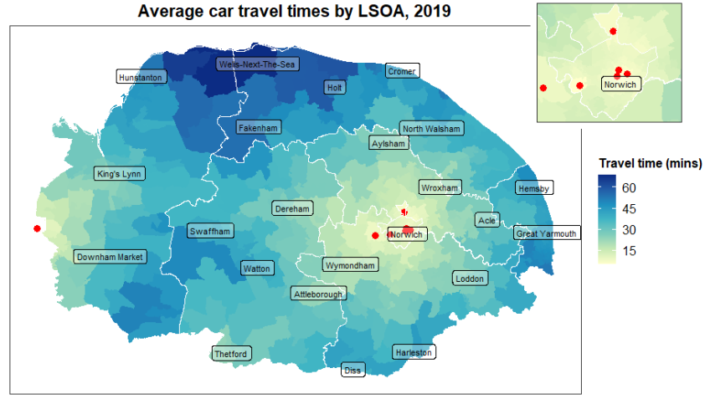
Transport connectivity
The map below shows the average travel time to an employment centre of 5,000+ people, by car for each LSOA in Norfolk.
Some areas of North Norfolk are over an hour, on average, by car from the nearest employment centre of 5,000+.
The chart shows that Norfolk has higher average travel times by all methods of transport to employment centres of 5k+ employees.
Note – an employment centre is defined as an LSOA where there is 5,000 or more jobs. These are marked on the source with briefcase logos, and in Power BI this would be interactive (and more would appear when you zoom in). However, as this is a screen shot, not all employment centres are shown, Norfolk has 7 LSOAs that meet the criteria, 5 in Norwich, 1 in Broadland and 1 in South Norfolk.
Source: Table JTS0401 – Journey time statistics: data tables (JTS) - GOV.UK (www.gov.uk)

Slide 54
Access to services
North Norfolk has the highest average travel times of all the districts across all methods of transport to key services.
Travel times are also higher across all methods of transport compared to the Norfolk, East of England and England average.
Average minimum travel time (in minutes) to reach the nearest key services* by mode of travel, 2019 | Public transport / Walking | Cycle | Car | Walking
Norfolk | 25 mins 24 secs | 23 mins 48 secs | 12 mins 54 secs | 43 mins 54 secs
Breckland | 30 mins 48 secs | 28 mins 6 secs | 13 mins 42 secs | 48 mins 0 secs
Broadland | 27 mins 18 secs | 23 mins 54 secs | 13 mins 24 secs | 49 mins 6 secs
Great Yarmouth | 17 mins 42 secs | 17 mins 12 secs | 10 mins 36 secs | 33 mins 30 secs
King’s Lynn and West Norfolk | 25 mins 48 secs | 26 mins 0 secs | 13 mins 12 secs | 51 mins 6 secs
North Norfolk | 34 mins 6 secs | 35 mins 18 secs | 17 mins 54 secs | 57 mins 36 secs
Norwich | 15 mins 42 secs | 12 mins 54 secs | 9 mins 24 secs | 22 mins 0 secs
South Norfolk | 28 mins 6 secs | 25 mins 24 secs | 13mins 24 secs | 50 mins 6 secs
East of England | 20 mins 42 secs | 18 mins 36 secs | 11 mins 18 secs | 34 mins 6 secs
England | 17 mins 54 secs | 15 mins 36 secs | 10 mins 18 secs | 28 mins 0 secs
* The average of minimum journey times to medium sized centres of employment (500-4999 jobs), primary schools, secondary schools, further education, GPs, hospitals, food stores and town centres.
Source: Table JTS0104 – Journey time statistics: data tables (JTS) - GOV.UK (www.gov.uk)

Slide 55
Location of usual residence and place of work
25.4% of people in Norfolk worked mainly at or from home in 2021, compared to 31.5% of people in England.
The percentage of people who mainly work at or from home in North Norfolk is 24.3%. This is lower than the Norfolk, East of England and England average.
Excluding those who work from home, North Norfolk has the second highest proportion of people both living and working in the same district (66.0%).
North Norfolk also had 29.8%% of people of usual residence travelling out of Norfolk to work elsewhere in the UK.
 | Percentage of people who work mainly at or from home
Norfolk | 25.4%
Breckland | 21.9%
Broadland | 30.3%
Great Yarmouth | 16.6%
King’s Lynn and West Norfolk | 20.5%
North Norfolk | 24.3%
Norwich | 29.6%
South Norfolk | 31.5%
East of England | 31.9%
England | 31.5%
Please note: due to the Census being taken while national lockdowns and the furlough scheme were in place, the ONS advise caution when looking at travel and working patterns, so these should be seen as estimates only.
The numbers shown are calculated on the available data with more information available here: Travel to work quality information for Census 2021 - Office for National Statistics (ons.gov.uk)
Source: Travel to work, England and Wales - Office for National Statistics (ons.gov.uk) and ODWP01EW from Origin-destination data, England and Wales: Census 2021 - Nomis - Official Census and Labour Market Statistics (nomisweb.co.uk)

Slide 56
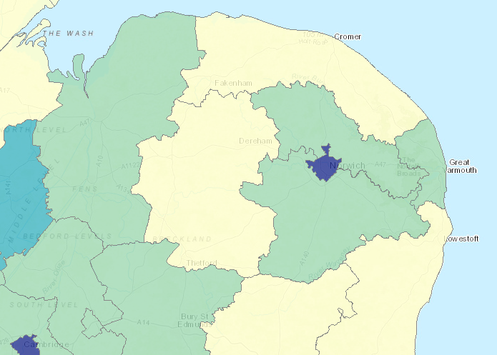
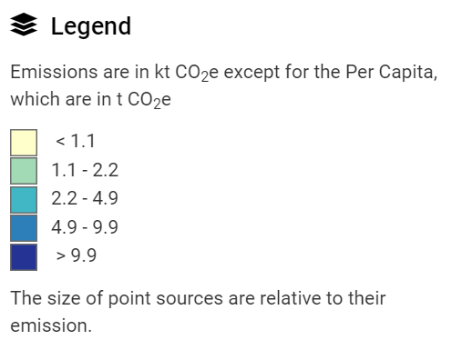
Emissions per km – Norfolk districts
The Local and Regional GHG interactive map show emissions for each Local Authority split by sectors.
2021 data for emissions per km (kt CO2E) is shown below:
  Breckland 0.9
  Broadland 1.4
  Great Yarmouth 2.2
  KL & WN 1.2
  North Norfolk 0.8
  Norwich 12.7
  South Norfolk 1.2
Transport is the single biggest contributor to Norfolk’s carbon emissions accounting for 26%, and of this 92% is from road vehicles.
The second biggest contributor is Domestic emissions (21%), followed by Agriculture emissions (20%).
Source: Local Authority GHG Map (beis.gov.uk)

Slide 57
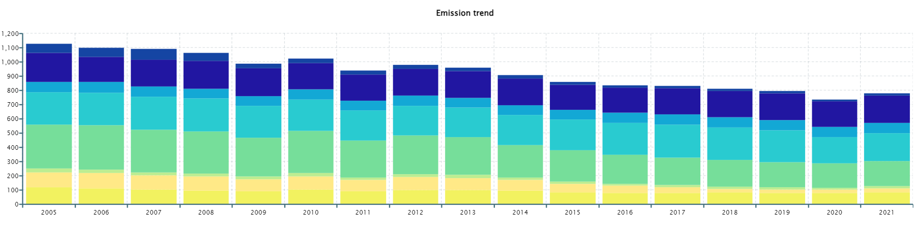
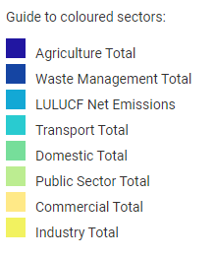
Emissions over time – North Norfolk
North Norfolk (2021 Data) | GHG emissions
Grand Total | 782.9
Industry Total | 85.5
Industry Electricity | 24.2
Industry Gas | 28.6
Industry 'Other' | 32.6
Large Industrial Installations | 0.0
Commercial Total | 26.4
Commercial Electricity | 21.3
Commercial Gas | 4.5
Commercial 'Other' | 0.6
Public Sector Total | 16.1
Public Sector Electricity | 8.4
Public Sector Gas | 7.5
Public Sector 'Other' | 0.2
Domestic Total | 176.7
Domestic Electricity | 51.2
Domestic Gas | 67.1
Domestic 'Other' | 58.5
Transport Total | 198.0
Road Transport (A roads) | 75.6
Road Transport (Motorways) | 0.0
Road Transport (Minor roads) | 94.9
Diesel Railways | 0.7
Transport 'Other' | 26.8
LULUCF Net Emissions | 72.2
Net Emissions: Forest land | -62.0
Net Emissions: Cropland | 81.4
Net Emissions: Grassland | 31.4
Net Emissions: Wetlands | 15.1
Net Emissions: Settlements | 5.8
Net Emissions: Harvested Wood Products | 0.0
Net Emissions: Indirect N₂O | 0.4
Agriculture Total | 191.2
Agriculture Electricity | 12.8
Agriculture Gas | 0.8
Agriculture 'Other' | 14.8
Agriculture Livestock | 83.9
Agriculture Soils | 79.0
Waste Management Total | 16.8
Landfill | 4.8
Waste Management 'Other' | 12.0
The chart shows greenhouse gas emissions (kt CO2E) between 2005 and 2021 for North Norfolk.
Note: The Waste Management and Agriculture sectors were included from 2018 onwards only.
LULUCF = land use, land use change and forestry sector
GHG = Greenhouse gas
North Norfolk (2021 Data)
Per Capita Emissions (tCO₂e) | 7.6
Population ('000s, mid-year estimate) | 103.3
Emissions per km² (kt CO₂e) | 0.8
Area (km²) | 990
Source: Local Authority GHG Map (beis.gov.uk)

Slide 58
Produced by the Norfolk Office of Data & Analytics (NODA)
Date correct as of March 2024

